Slide 1

Fundamentals of Electric Circuits 2020.3
Chapter 4
Circuit Theorems

Slide 2
Chapter 4 Circuit Theorems
4.1 Motivation
4.2 Linearity Property
4.3 Superposition
4.4 Source Transformation
4.5 Substitution theorem
4.6 Simplification of a one-port network
4.7 Thevenin’s Theorem
4.8 Norton’s Theorem
4.9 Maximum Power Transfer

Slide 3

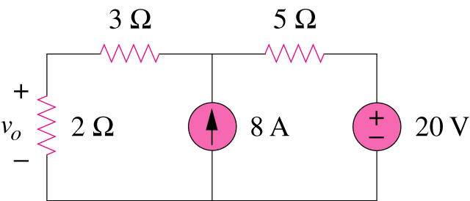
If you are required to determine the voltage across 2Ω resistor, we can first replace the two resistors with only one resistor to simplify the circuit.
4.1 Motivation
Are there any other method to simplify circuit analysis ?
What are they? And how?
Can you work it out by inspection?

Slide 4
4.1 Motivation
Some theorems are developed to simplify circuit analysis. Such theorems include Thevenin’s theorems and Norton’s theorems.
Since these theorems are applicable to linear circuits, we first discuss the concept of circuit linearity.
In addition to circuit theorems, we discuss the concepts of superposition, source transformation, and maximum power transfer in this chapter.

Slide 5

4.2 Linearity Property
linear circuit
Linear element: Linear relationship
A linear circuit: one circuit whose output is linearly related (or directly proportional) to its input.
Linearity is a combination of both the homogeneity (scaling) property and the additivity property.

Slide 6

4.2 Linearity Property
The homogeneity property: if the input (also called the excitation) is multiplied by a constant, then the output (also called the response) is multiplied by the same constant.
For a resistor, for example, Ohm’s law relates the input i to the output v .
v = iR
If the current is increased by a constant k, then the voltage increases correspondingly by k, that is,
Homogeneity (scaling) property
v = i R → k v = k i R

Slide 7

4.2 Linearity Property
The additivity property: the response to a sum of inputs is the sum of the responses to each input applied separately.
Using the voltage-current relationship of a resistor, if
v₁ = i₁R
v₂ = i₂R
then applying (i₁ + i₂) gives
Additive property
→ v = (i₁ + i₂) R = i₁R + i₂R = v₁ + v₂

Slide 8
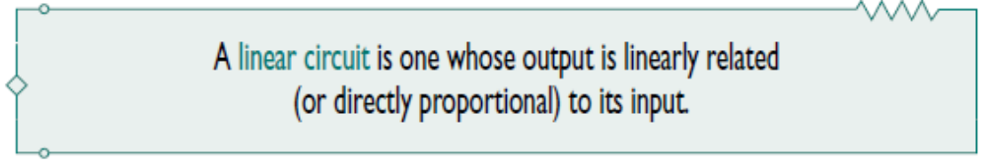

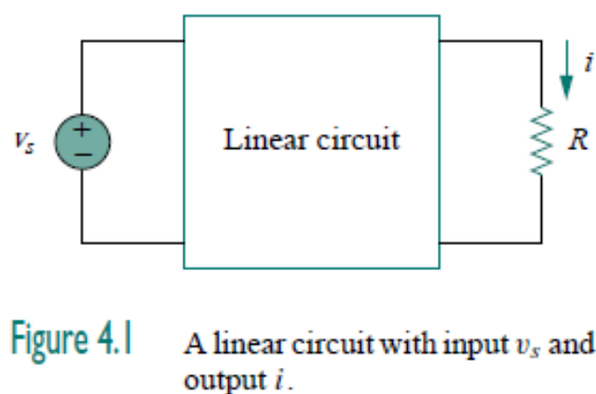
Consider the linear circuit shown in Fig. 4.1.
Suppose v_{s} = 10 V gives i = 2 A. According to the linearity principle, v_{s} = 20 V will give i = 4 A.

Slide 9
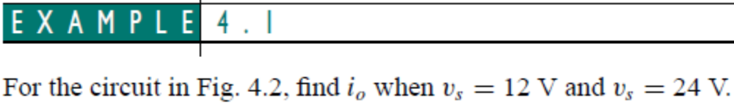
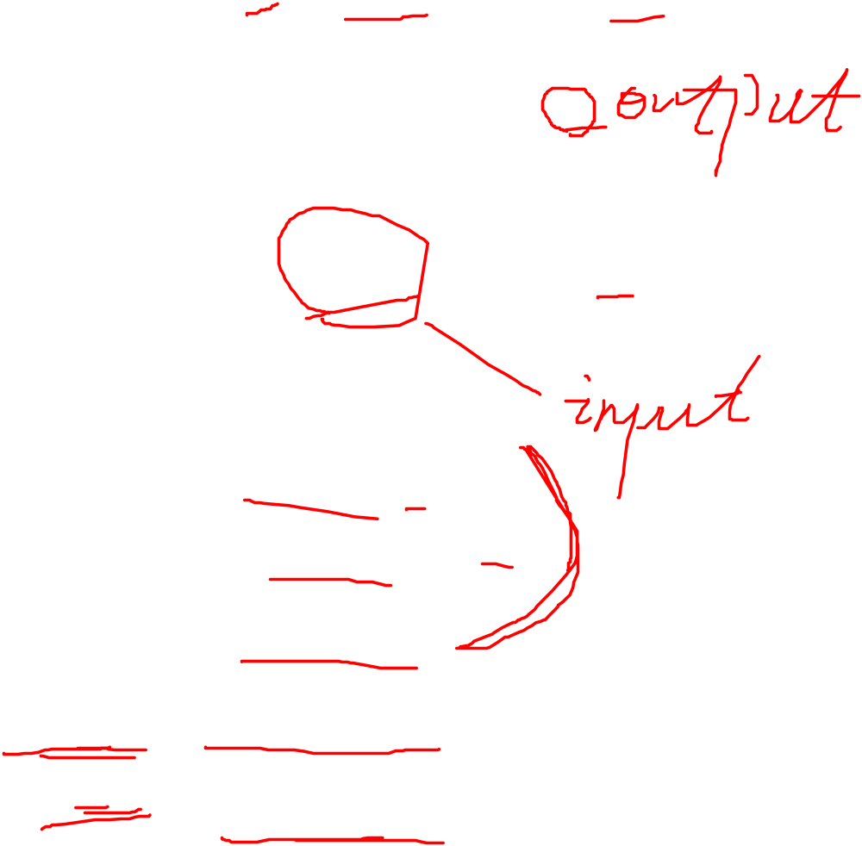
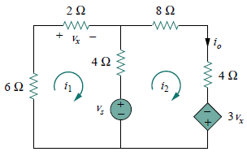
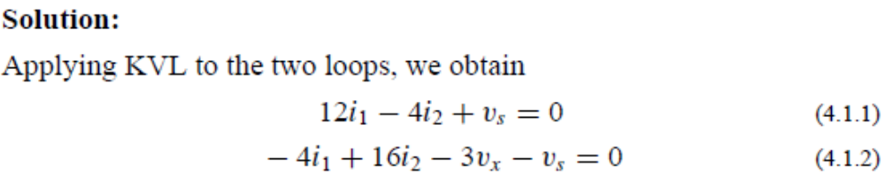





Controlling equation

Slide 10
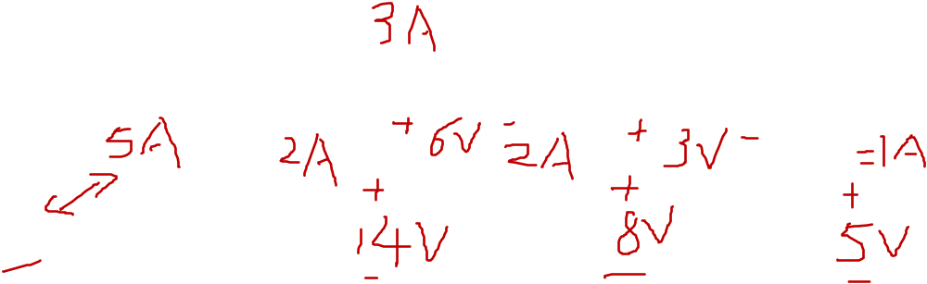

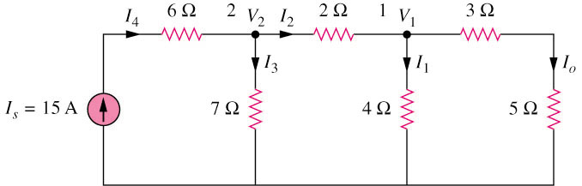
4.2 Linearity Property (2)
Example 4.2
Use linearity to find the actual value of I_{o} in the circuit shown below.
By assume I_{o} = 1 A,
Answer I_{o} = 3A

Slide 11
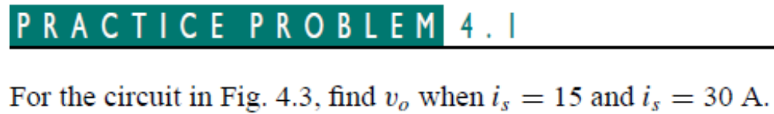

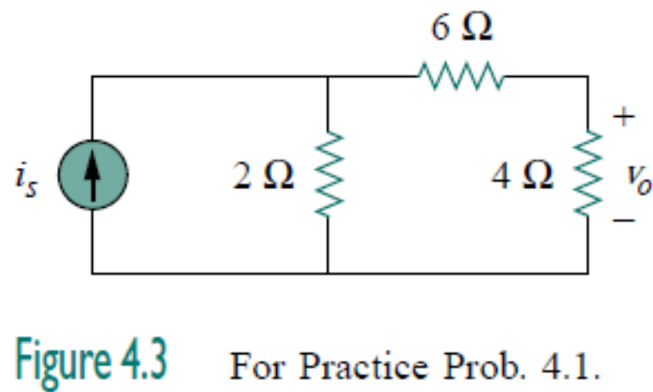


Slide 12
4.3 Superposition Theorem
If a circuit has two or more independent sources:
One way to solve the circuit is nodal or mesh analysis method.
Another way is to first determine the contribution of each independent source to the variable and then add them up.
The latter approach is known as the superposition.

Slide 13
4.3 Superposition Theorem
It states that the voltage across (or current through) an element in a linear circuit is the algebraic sum of what each independent source acting alone.
The principle of superposition helps us to analyze a linear circuit with more than one independent source by calculating the contribution of each independent source separately.

Slide 14
4.3 Superposition Theorem
We must keep two things in mind:
One independent source acting alone, means all other independent sources are turned off. This implies that we replace
  every voltage source by 0 V (or a short circuit),
  every current source by 0 A (or an open circuit).
A voltage source set to zero acts like a short circuit
A current source set to zero acts like an open circuit
i
0A
0V
i
u
u
“turned off” or “zeroed out”,
“turned off” or “zeroed out”,
2. Dependent sources are left.

Slide 15
4.3 Superposition Theorem (3)
Steps to apply superposition principle
Turn off all independent sources except one source. Find the output (voltage or current) due to that active source using nodal or mesh analysis.
Repeat step 1 for each of the other independent sources.
Find the total contribution by adding algebraically all the contributions.
Pay attention to the reference direction.

Slide 16
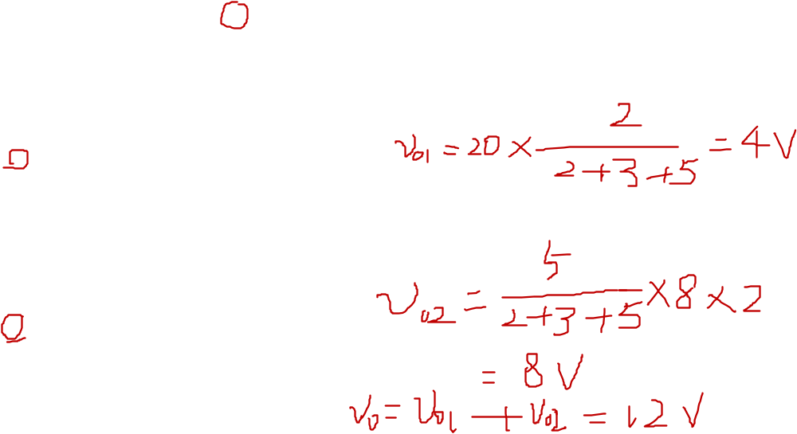
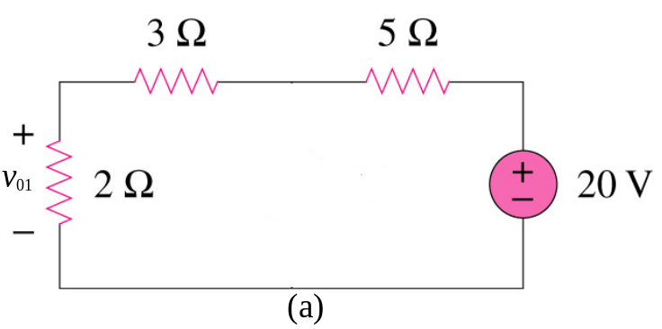
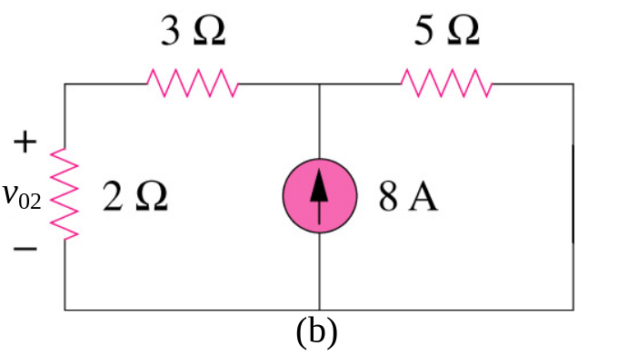
4.3 Superposition Theorem
We consider the effects of 8A and 20V one by one, then add the two effects together for final v_{o}.

Slide 17
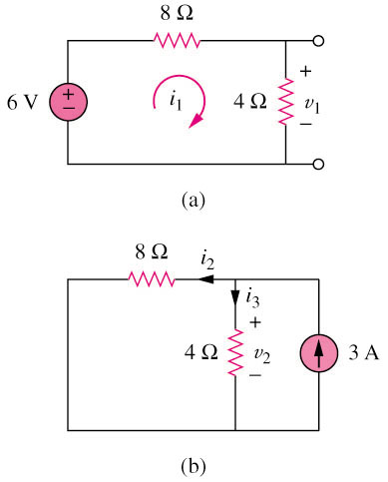

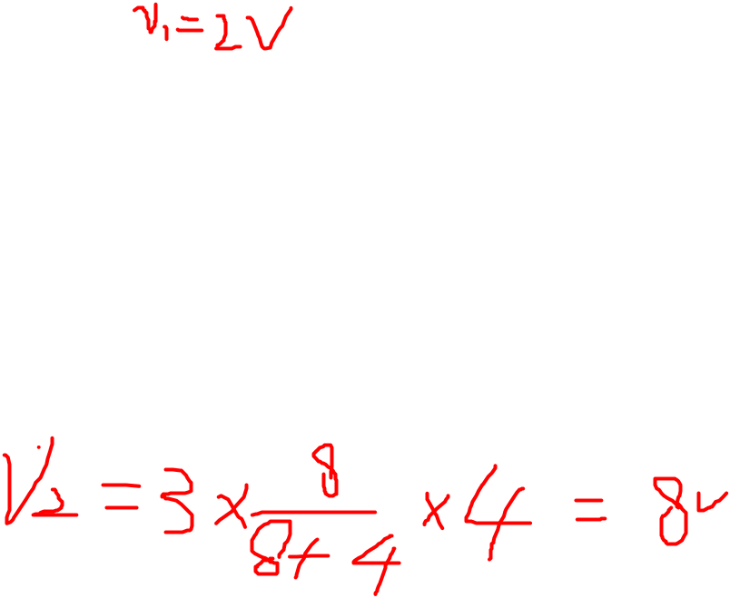
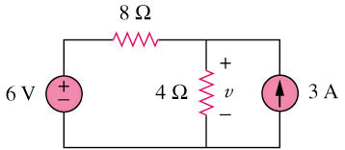
4.3 Superposition Theorem (5)
Example 2 Use the superposition theorem to find v in the circuit shown below.
3A is discarded by open-circuit
6V is discarded by short-circuit
Answer v = 10V

Slide 18
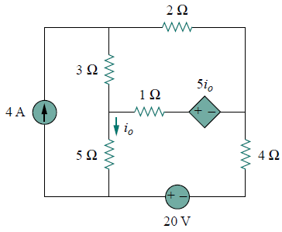
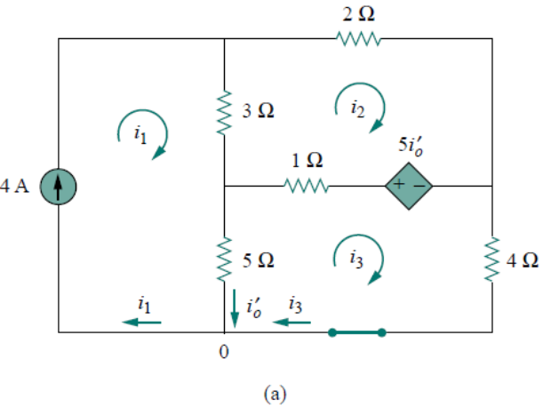
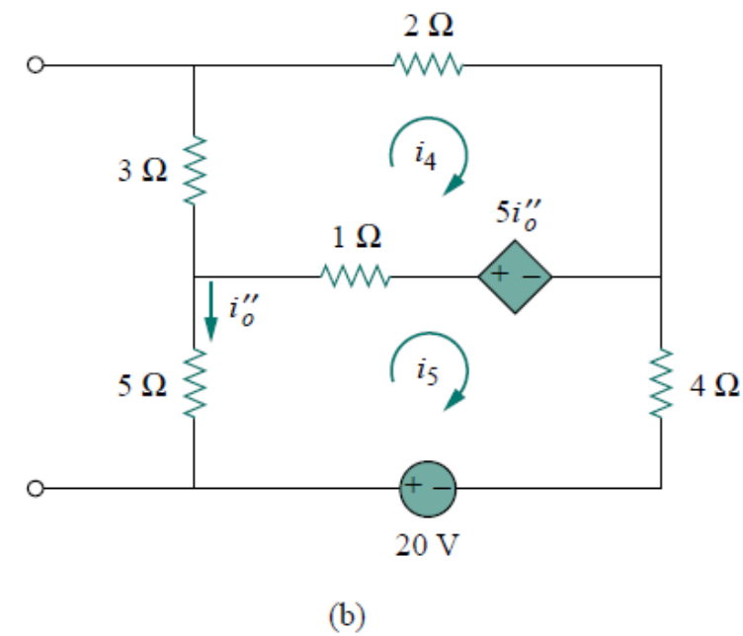
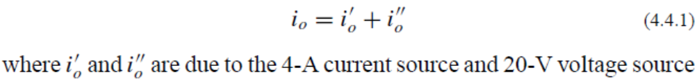
Example 4 Use superposition to find i₀ in the circuit below.
The circuit involves a dependent source, which must be left intact. We let.

Slide 19
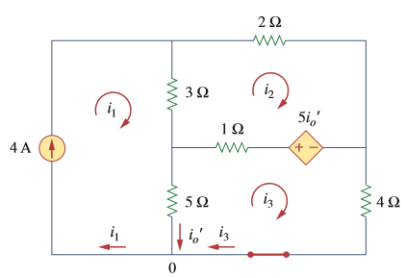

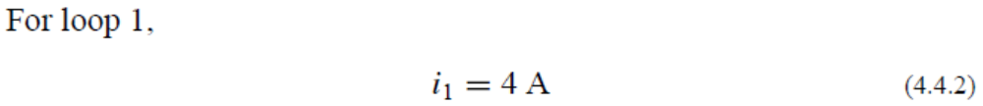
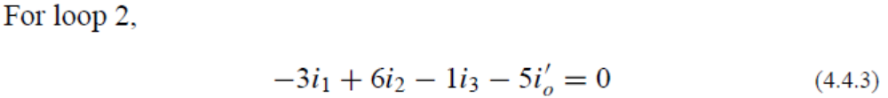

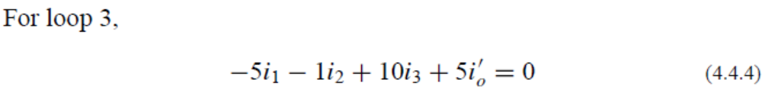
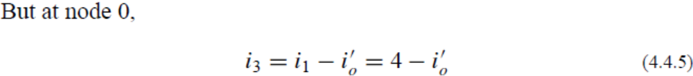
To obtain i_{o}’, we turn off the 20-V source so that we have the circuit in Fig. 4.10(a). We apply mesh analysis in order to obtain i_{o}’.

Slide 20
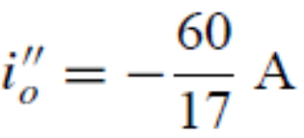
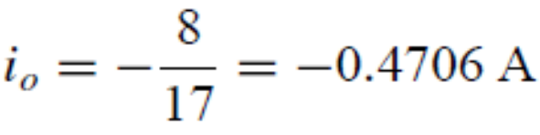
To obtain i_{o}’’, we turn off the 4-A current source so that we have the circuit in Fig. 4.10(b). We apply mesh analysis in order to obtain i_{o}’’.
For loop 4, KVL gives
For loop 5, KVL gives

Slide 21
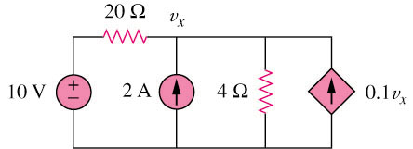
Example 6
Use superposition to find v_{x} in the circuit below.
2A is discarded by open-circuit
10V is discarded by short-circuit
Dependant source keep unchanged
20 Ω
v₁
20 Ω
v₂
+
−
10 V
4 Ω
0.1v₁
2 A
4 Ω
0.1v₂
(a)
(b)
Answer Vx = 12.5V

Slide 22
